Slide 1
Text Clustering In R
Lecturer: WU CHENG-LIN

Slide 2
Clustering Algorithms
K-means Clustering & Hierarchical Clustering

Slide 3
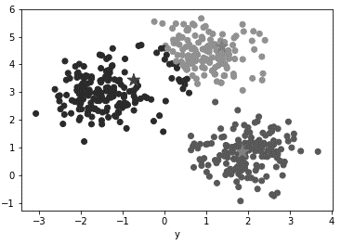

Before we dive into the topic …
How many clusters should be in the following figure?
OR

Slide 4

Before we dive into the topic …
Compactness!
Data points in a cluster should be close to each other as possible.
diameter of green cluster is large, BAD!
diameter of green cluster is small

Slide 5
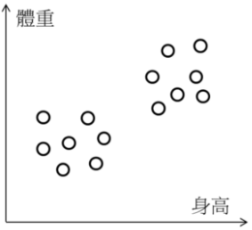
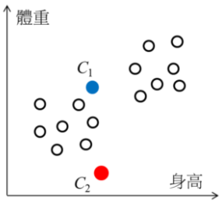
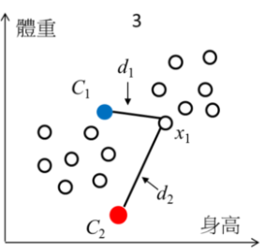
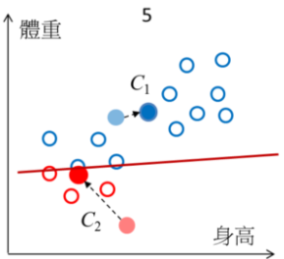
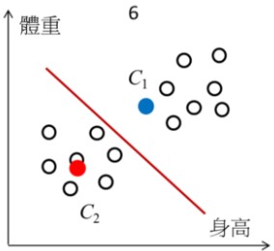
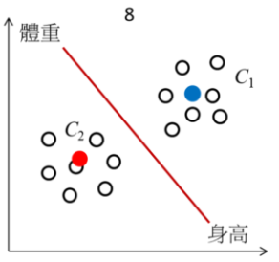
K-means Clustering
屬於一種分割式分群(Partitional Clustering)：需事先指定分群數目，經過不斷的迭代，直到群內的變異最小。
d1 < d2, x1 判給 C1
分出兩個群，更新群的中心
新的群中心再產生新的分群方式
不斷執行，直到群的中心不再變動，完成

Slide 6
K-means Clustering
先設定好要分成多少(K)群
然後在空間中隨機設定 K 個群中心
每個資料點向所有群中心算距離 (e.g. Euclidean, cosine, jaccard, etc.)
將每個資料點分發，判給距離最近的那個群中心
每個群中心利用被分發過來的資料點，計算出新的群中心
一直重複3–5，直到所有群中心不在有太大的變動(收斂)，結束
Loop
Video visualization: https://www.youtube.com/watch?v=nXY6PxAaOk0

Slide 7
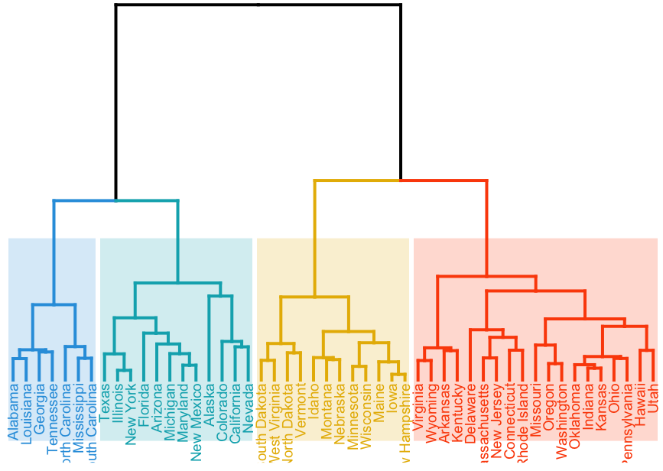
Hierarchical Clustering
不需指定分群數目，讓資料自動由上往下/由下往上結合起來:
群聚樹 Cluster Dendrogram
由上往下 (Top-Down)
由樹狀結構的頂端開始，將群聚逐次分裂
由下往上 (Bottom-Up / Agglomerative)
從樹狀結構的底部開始，將資料或群聚逐次合併

Slide 8
Hierarchical Clustering (Agglomerative)
一開始我們將每一筆資料視為一個 cluster，假設我們現在擁有 n 筆資料，則將這 n 筆資料視為 n 個 cluster：
將每筆資料視為一個 cluster Ci, i=1 to n.
找出所有 cluster 間，距離最接近的兩個 cluster → Ci、Cj
合併 Ci、 Cj 成為一個新的 cluster
假如目前的 cluster 數目多於我們預期的 cluster 數目，則反覆重複步驟二至三，直到 cluster 數目已將降到我們所要求的數目。
Loop

Slide 9
Hierarchical Clustering (Agglomerative)
計算 cluster 間的距離的方法:
Single-linkage -- 兩個 cluster 中，最接近的兩點間的距離
Complete-linkage -- 兩個 cluster 中，最遠的兩點間的距離
Average-linkage -- 兩個 cluster 之間，各點與各點間距離總和的平均
Ward’s method -- 在將兩個 cluster 合併後，各點到合併後的群中心的距離平方和

Slide 10
Programming Flow
Be prepared to write some code

Slide 11
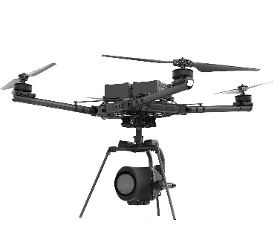
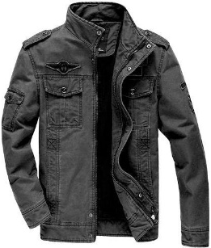
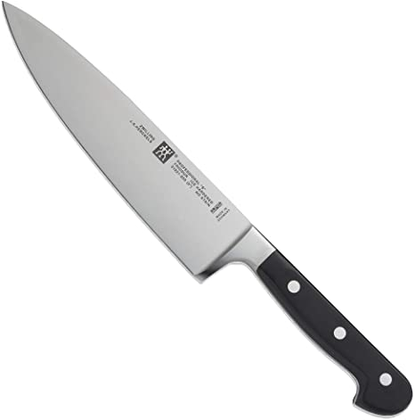
Dataset
Product Description (.CSV)
There’re 12 items in total.
Each product belongs to one of these categories:
Drone
Jacket
Knife
Dataset Preview
name
description
DJI Mavic 2 Pro
The Mavic 2 Pro is a compact, foldable drone that's …
Bomber Jackets
Also known as a flight jacket, a bomber jacket is a short …
Chef’s knife
A chef’s knife is one of the most versatile tools …

Slide 12
Programming Flow
Load dataset
Data preprocessing
Remove stopwords
Do word stemming
Trim excessive whitespace
Create document-term matrix
Calculate similarity between documents
Execute clustering algorithm
Visualize clusters
Stopwords
tm::stopwords('english')
I, me, my, myself, we, our, ours, ourselves ……
Word Stemming
tm::stemDocument("working , works", language="english")
“work” , “work”
Word Stemming
tm::stripWhitespace(" Hello my friend ")
" Hello my friend "

Slide 13
Programming Flow
Document-term matrix (weighted by term freq)
Load dataset
Data preprocessing
Remove stopwords
Do word stemming
Trim excessive whitespace
Create document-term matrix
Calculate similarity between documents
Execute clustering algorithm
Visualize clusters
term 1
term 2
term 3
doc 1
freq
freq
freq
doc 2
freq
freq
freq
doc 3
freq
freq
freq
Document-term matrix (weighted by TF-IDF)
term 1
term 2
term 3
doc 1
tfidf
tfidf
tfidf
doc 2
tfidf
tfidf
tfidf
doc 3
tfidf
tfidf
tfidf

Slide 14
Programming Flow
Load dataset
Data preprocessing
Remove stopwords
Do word stemming
Trim excessive whitespace
Create document-term matrix
Calculate similarity between documents
Execute clustering algorithm
Visualize clusters
Similarity matrix ( = distance matrix )
doc 1
doc 2
doc 3
doc 1
similarity
similarity
similarity
doc 2
similarity
similarity
similarity
doc 3
similarity
similarity
similarity

Slide 15
Programming Flow
Load dataset
Data preprocessing
Remove stopwords
Do word stemming
Trim excessive whitespace
Create document-term matrix
Calculate similarity between documents
Execute clustering algorithm
Visualize clusters
K-Means:
kmeans (dist_matrix, K)
Hierarchical:
hclust(dist_matrix, method = "ward.D2")

Slide 16
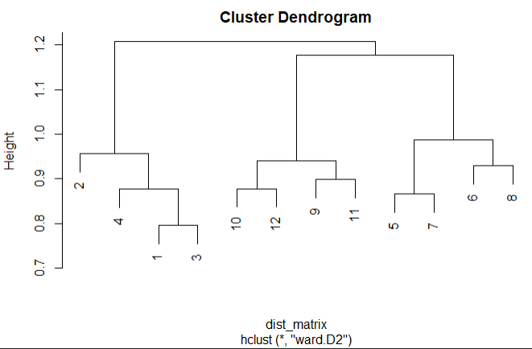
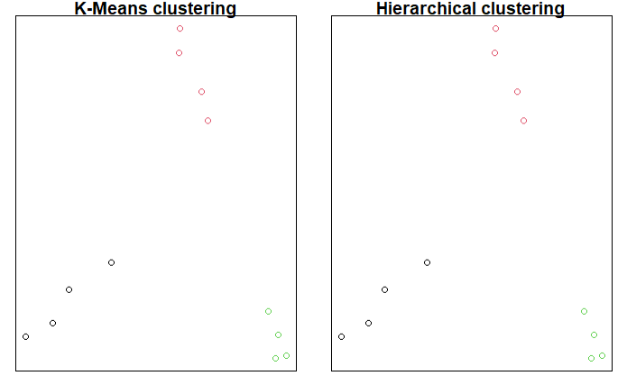
Programming Flow
Load dataset
Data preprocessing
Remove stopwords
Do word stemming
Trim excessive whitespace
Create document-term matrix
Calculate similarity between documents
Execute clustering algorithm
Visualize clusters

Slide 17
Run by Yourself
Download Dataset (.csv): https://reurl.cc/D6Mr3m
Download R Markdown: https://reurl.cc/m9bKoj

Slide 18
Follow-Up: TF-based Methods Limitation
They cannot capture the context of words, for example:
“cat, dog, rabbit, bird” are all animals (or pets)
“excellent, good, marvelous, awesome” are the same meaning
They cannot capture the context of ordered words, for example:
“be happy, not to be worried” vs. “be worried, not to be happy”
keywords of solution: word embedding, recurrent neural network, deep learning

Slide 19
Reference
機器學習: 集群分析 K-means Clustering
https://chih-sheng-huang821.medium.com/%E6%A9%9F%E5%99%A8%E5%AD%B8%E7%BF%92-%E9%9B%86%E7%BE%A4%E5%88%86%E6%9E%90-k-means-clustering-e608a7fe1b43
R筆記–(9)分群分析(Clustering)
https://rpubs.com/skydome20/R-Note9-Clustering
Introductory tutorial to text clustering with R
https://rstudio-pubs-static.s3.amazonaws.com/445820_c6663e5a79874afdae826669a9499413.html
Hierarchical Clustering (階層式分群法)
http://mirlab.org/jang/books/dcpr/dcHierClustering.asp?title=3-2%20Hierarchical%20Clustering%20(%B6%A5%BCh%A6%A1%A4%C0%B8s%AAk)&language=chinese

